Slide 1
Week 4 Report
Qi Luo, Sidharth Suravarapu
OSHKOSH PROJECT: Assessment of Autonomous Driving Software Performance on Edge Devices

Slide 2
Primary Objectives
1
Implement Autoware on Ambarella edge device
2
Evaluate the capability of the Ambarella devices
3
Compare the performance of Ambarella device to the NVIDIA ORIN

Slide 3
Completed Tasks
Docker Installation on Ambarella Box
Maps refuse to load (Path/ROS2)
No graphic acceleration
Notes:
Can we run Autoware on Ambrella native system directly?
How do the stack compare to Nvidia Jetson.

Slide 4
Ongoing Tasks
Ambarella Remote Desktop
Beetle Demo Research

Slide 5
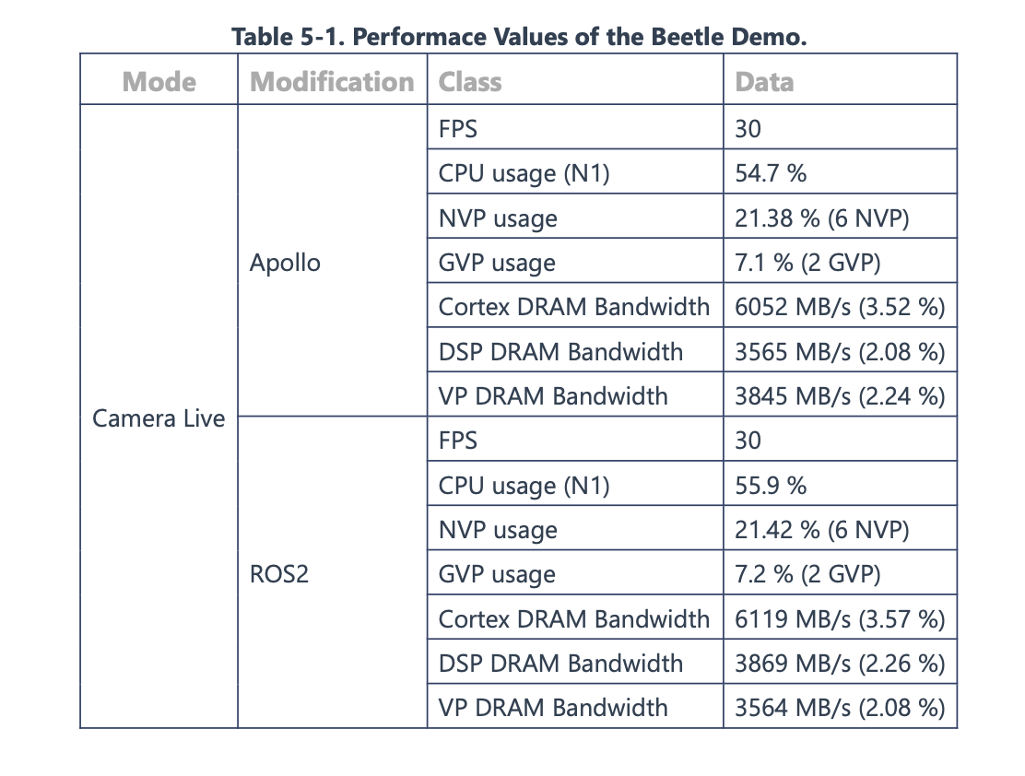
Investigating Ambarella SOC: N1
NVP (Neural Vector Processor)
“high performance, low latency, and low-power NN processing” + transformer network support
GVP (General Vector Processor)
traditional CV processing + optimization for radar
How do programs access them?
Ex. Beetle Demo
How can we benchmark them?

Slide 6
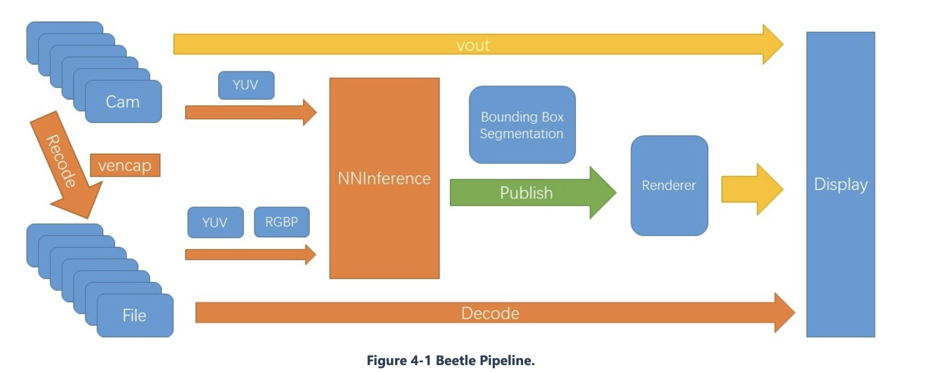

Beetle Demo: Architecture
Gstreamer captures camera data and sends it to NNInference module
NNInference module publishes bounding boxes via ROS2

Slide 7
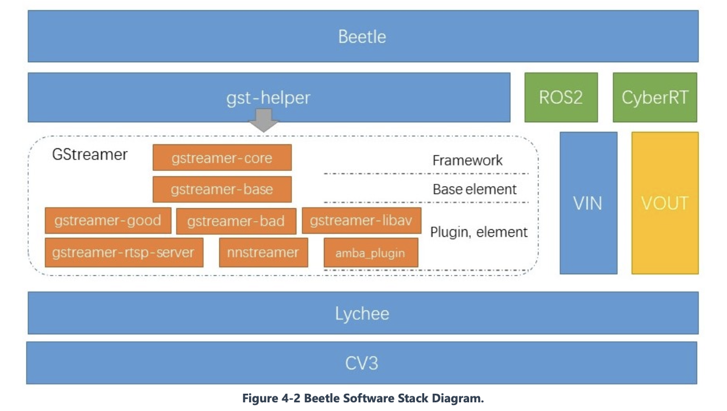
Beetle Demo: Architecture
How does inferencing take place?
Review SDK - CNNGen Toolchain

Slide 8
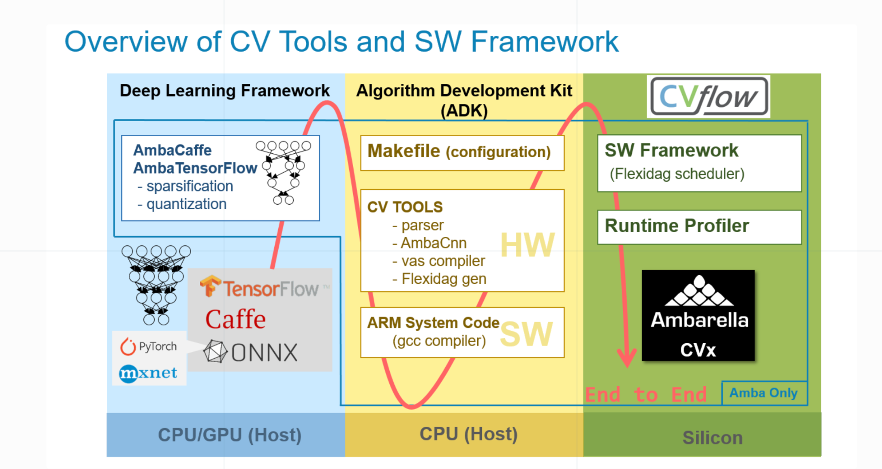
CVFlow - Brief Overview
Users can map their own CNN networks trained with industry-standard tools (e.g., Caffe, TensorFlow, PyTorch) to run on Ambarella processors.
https://www.ambarella.com/blog/the-story-of-cvflow/

Slide 9
Issues
Fedora vs. Ubuntu (Ambarella Driver SDK)
Equipment: Power measurement
Connect with someone from Ambarella
Why is the beetle demo Lychee dependent?
Emulator (Nvidia -> Ambarella)?

